Slide 1
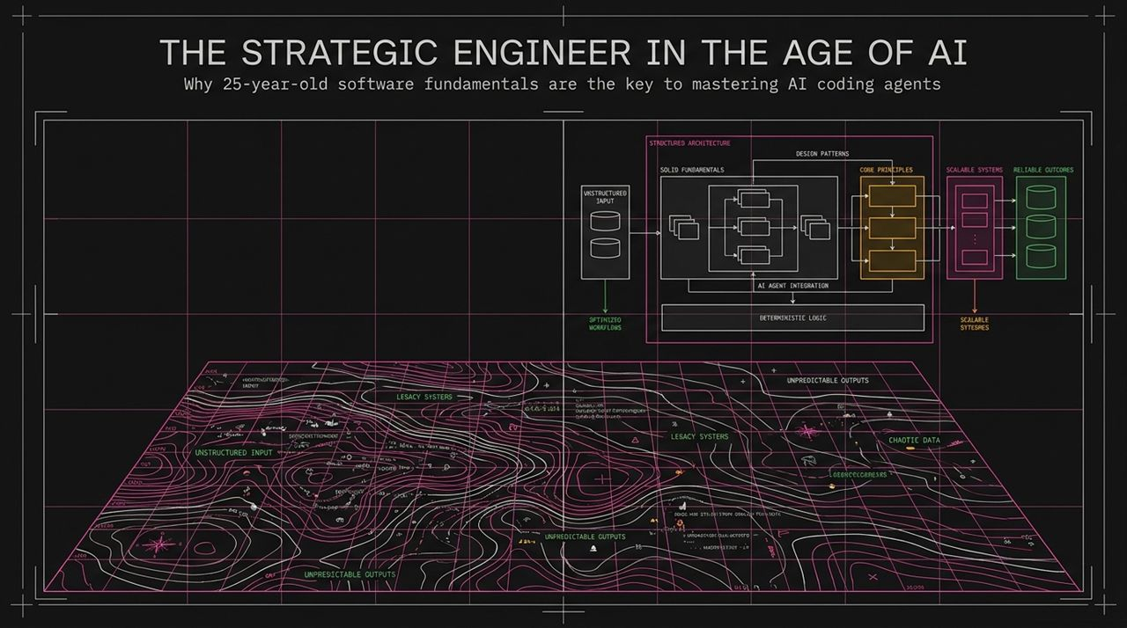
Notes:
Introduction: Welcome everyone. Today, we're talking about modern software engineering in the era of AI coding agents and LLMs. The title of this presentation is The Strategic Engineer in the Age of AI, and our primary focus is why 25-year-old classic software fundamentals are actually the most important key to mastering AI coding agents.
The Visual Context: On the left of this visual, you see a chaotic topology representing unstructured inputs, legacy systems, and unpredictable outputs. On the right, you see a structured architecture built on SOLID fundamentals, design patterns, deterministic logic, and AI agent integration.
Core Message: AI hasn't made fundamental engineering principles obsolete; in fact, it has elevated them. When you give an AI agent unstructured context and vague goals, you generate technical debt at unprecedented speeds. The strategic engineer uses classic architectural foundations to tame agentic workflows and deliver scalable, reliable software.
https://www.youtube.com/watch?v=4DhcSPkEbwI

Slide 2
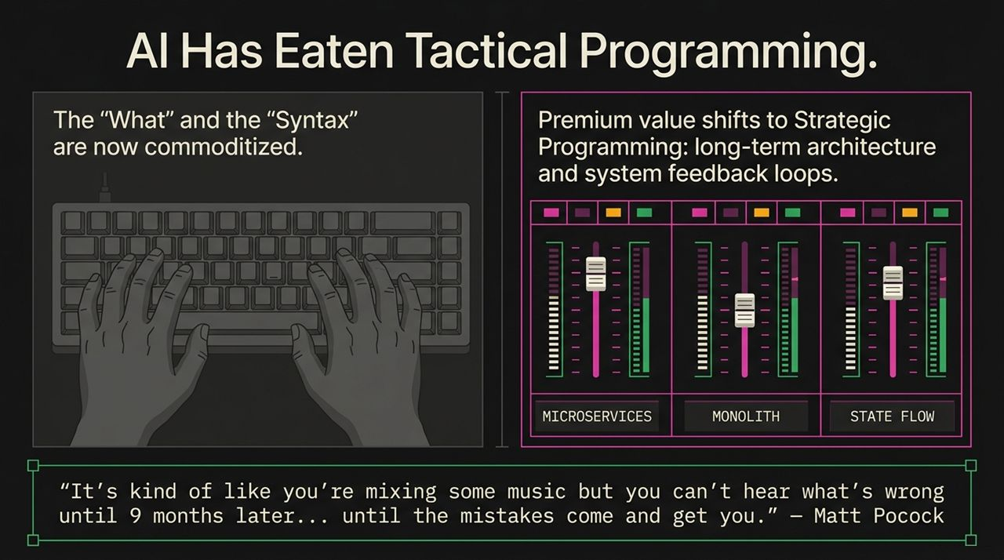
Notes:
Key Concept: We are witnessing a massive paradigm shift in where human value sits in the software lifecycle. Tactical programming—the "what" and the "syntax," such as writing boilerplate, syntax, unit test syntax, and routine functions—has effectively been commoditized by AI models.
Matt Pocock Quote Reference: Matt Pocock described software architecture with a great analogy: "It's kind of like you're mixing some music but you can't hear what's wrong until 9 months later... until the mistakes come and get you."
The Hand-Off Matrix:
Tactical Programming: This is now the Agent's job. It focuses on syntax and immediate execution. Its standalone economic value is rapidly approaching zero.
Strategic Programming: This is the Human's job. It focuses on long-term architecture, data flow, system entropy, and feedback loops. Its value approaches infinity because strategic decisions determine whether your application survives 9 to 12 months down the line.
Takeaway: Your true leverage as a developer today comes from adjusting the architectural sliders, not from typing individual notes on the keyboard.

Slide 3
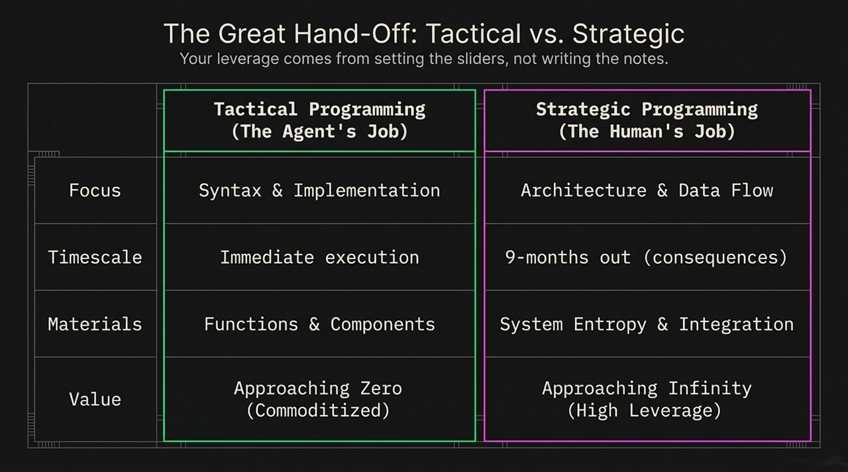
Notes:
The Illusion: It is easy to throw a vague prompt at an AI model and get a working script ("YOLO Prompting"). But when you attempt this on enterprise-scale codebases, the strategy crumbles.
Three Critical Failure Modes:
The Communication Gap: AI agents cannot read your mind. They don't know your team's unwritten conventions, architectural preferences, or subtle edge-case requirements unless explicitly communicated.
The Context Cliff: As context windows expand, people assume they can dump an entire repository into an agent. However, as the token count grows, attention degrades. The model struggles to prioritize "important voices" amidst the noise.
The Amnesia Problem: Unlike human developers who build localized institutional memory over time, agents wake up every single session as a complete stranger to your codebase.
Conclusion: You cannot rely on unstructured prompts or agent intuition to build production-grade software at scale.

Slide 4
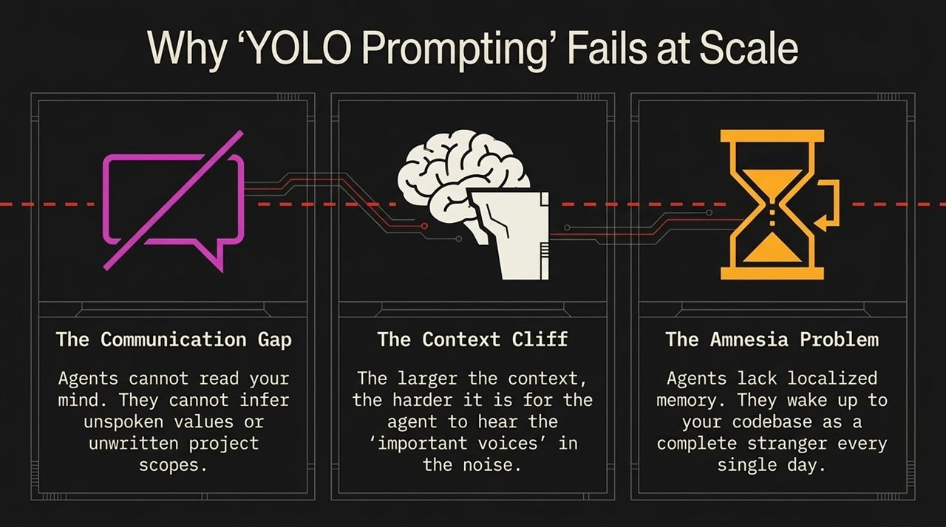
Notes:
Deep Dive into Model Performance: Even though modern frontier models advertise 1-million or 2-million token windows, their practical "Smart Zone" for complex reasoning is significantly narrower.
The Graph Analysis: Look at the chart on this slide.
From 0 to ~150,000 tokens, attention and reasoning accuracy remain high and reliable ("The Smart Zone").
Past 150k tokens, signal degradation sets in rapidly. Every additional token competes for attention, leading to hallucinated context, lost relationships, and logical oversights.
Actionable Rule: Never stretch an agent's context window to its theoretical limit. To keep agents operating strictly inside the ~150k Smart Zone, you must decompose large feature requests into tightly scoped, modular units of work.

Slide 5
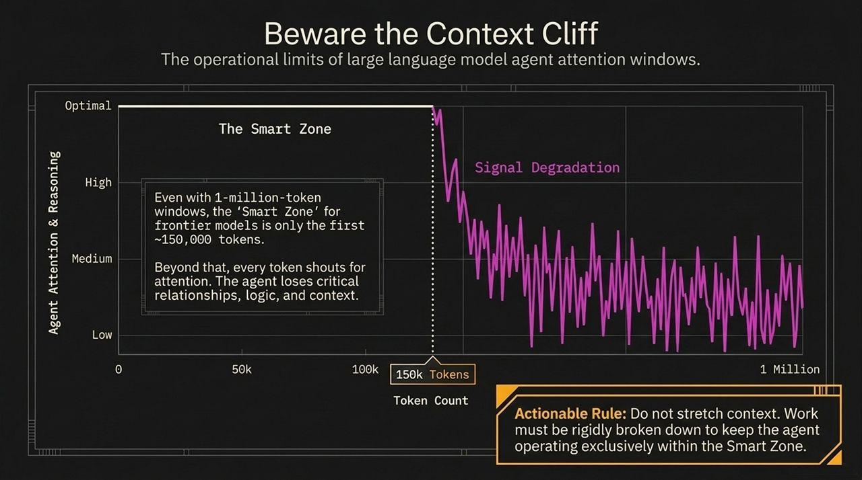
Notes:
Human vs. Agent Memory: Human engineers navigate bad codebases by relying on historical memory—we remember why a hacky workaround was written six months ago. AI agents do not have this luxury. They suffer from total amnesia on every run.
Core Insight: You can no longer rely on implicit institutional knowledge to mask technical debt. Every single time you press 'Enter', the agent approaches your codebase like a brand-new junior developer on day one.
Engineering Mandate: If your codebase is chaotic, poorly typed, or loosely structured, the amnesiac agent will struggle. You must optimize the codebase itself to be a self-describing, perfectly legible environment for an external observer.

Slide 6
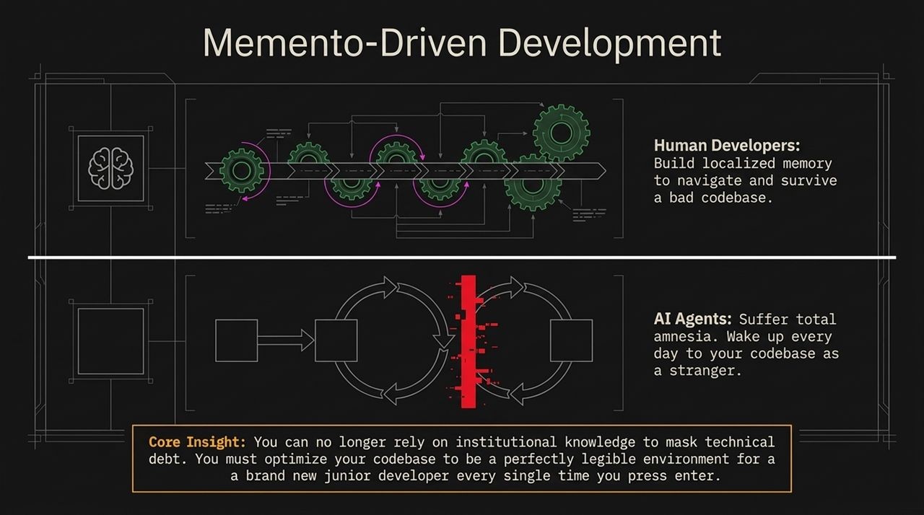
Notes:
Moving Away from Chat-Box Coding: To achieve predictable engineering outcomes, we must shift from ad-hoc chat interface interactions to a deterministic, finite-state machine pipeline.
PDF
The Three-Stage Workflow:
Stage 1: Alignment (Skill: Grill Me): Before writing any code, we close the communication gap by forcing the agent to question our requirements.
Stage 2: Mapping (Skill: Wayfinder): For large features that exceed the 150k token Smart Zone, we break down specifications into a persistent map of small, isolated tickets.
Stage 3: Execution (Skill: Spec-to-Tickets): The agent executes tasks in single-session Smart Zones, clearing its context window after completing each node.

Slide 7
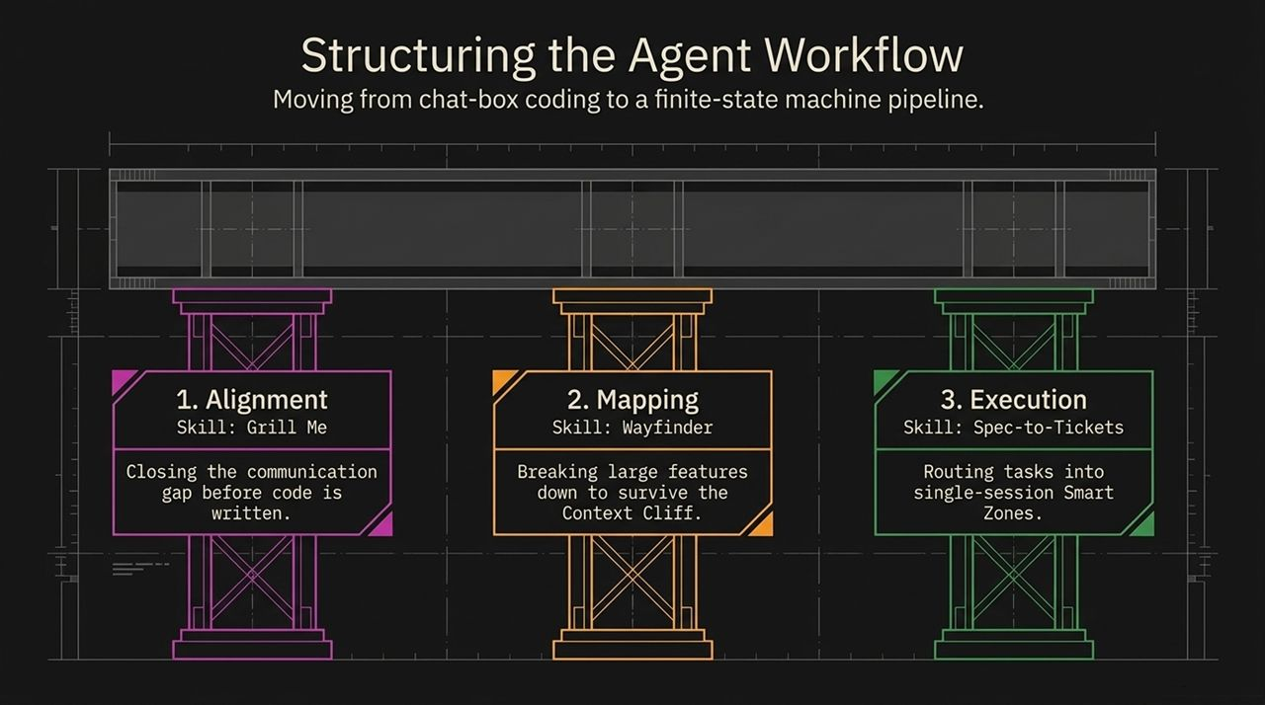
Notes:
Concept: Reverse the prompting dynamic. Instead of commanding the agent to "build X," instruct the agent to relentlessly interrogate you about edge cases, authentication mechanisms, and system constraints before it touches a single line of code.
Real-World Example: In the terminal example shown on screen, the agent pauses execution and asks three critical questions regarding Bearer vs JSON authentication, rate limiting behavior at 1000 requests/day, and database update concurrency.
Podcast Insight: Matt Pocock noted on The Pragmatic Engineer podcast that when he ran grill-me while building a simple API endpoint, the agent asked him 35 detailed questions, forcing him to resolve architectural ambiguities up front.
Impact: Grill Me eliminates agent guesswork, enforces security decisions, and forces human engineering discipline prior to execution.

Slide 8
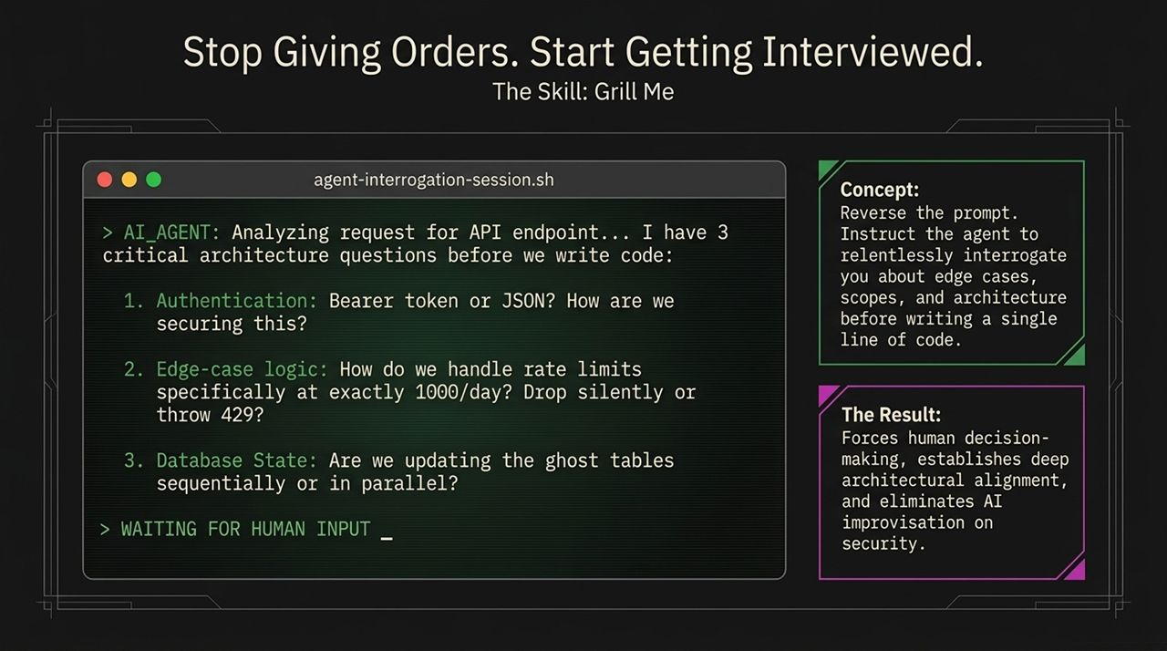
Notes:
Concept: When features are too large to fit in a single 150k token context session, you build a persistent dependency graph—a "Map" of tickets.
Execution Cycle:
Load Map: Load the overarching ticket network into the agent.
Select Node: The agent picks exactly ONE isolated task/node to execute.
Execute: The task is executed inside the 150k Smart Zone.
Update Map: Mark the node as complete, update dependent status, and output state.
Flush Context: Forcefully wipe the agent's context memory clean.
Repeat: Move to the next node with a fresh context window.
Outcome: Prevents context degradation and keeps the agent operating at peak accuracy across multi-step projects.

Slide 9
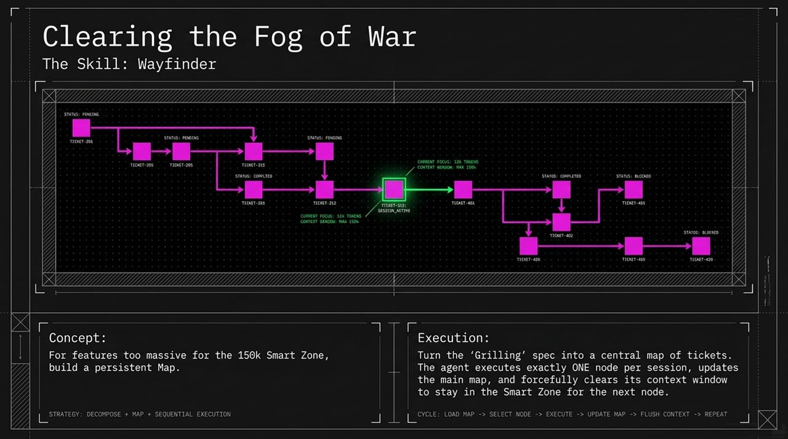
Notes:
Core Insight: Don't waste time inventing vague new "English prompt engineering" frameworks. The ultimate cheat code for working with modern AI agents is leveraging classic software architecture books:
The Pragmatic Programmer (Hunt & Thomas)
Domain-Driven Design (Eric Evans)
A Philosophy of Software Design (John Ousterhout)
Why It Works: These foundational texts make up a significant portion of the high-quality training data for LLMs. When you invoke concepts from these books, you align the agent's latent space directly with decades of battle-tested engineering design principles.

Slide 10
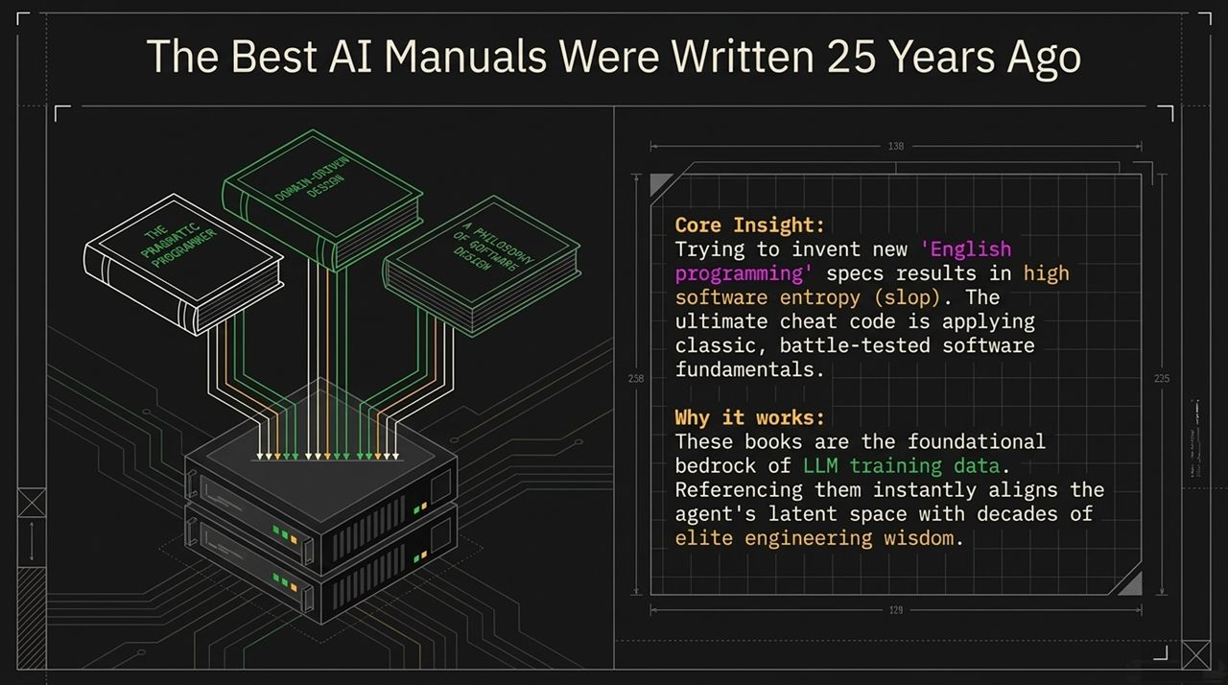
Notes:
Bad Pattern (Horizontal Layering): Left to its own devices, an AI agent will build large horizontal layers in isolation—an entire UI layer, then an entire API layer, then a DB layer. When you finally assemble them, integration fails catastrophically.
Good Pattern (Tracer Bullets): Borrowed directly from The Pragmatic Programmer, instruct the agent to build a Tracer Bullet—a thin, end-to-end vertical slice that connects UI, API, and DB layers instantly.
Benefit: A tracer bullet creates an immediate feedback loop. It confirms that the system integration works end-to-end before you allow the agent to fill out the remaining features.

Slide 11
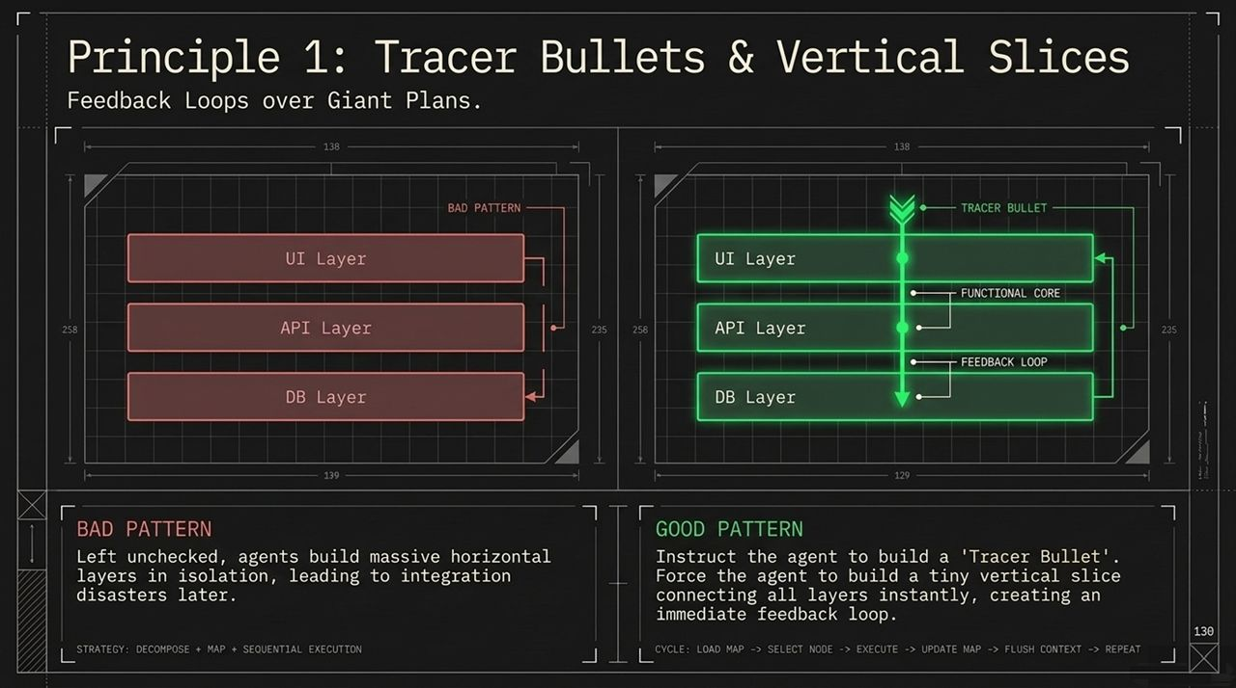
Notes:
Concept: Matt Pocock highlights the concept of "Leading Words". Highly specific domain jargon acts as a precise key for the agent's latent space.
Examples of Leading Words:
"Tracer Bullet"
"Deep Modules"
"Materialization Cascade"
"Ubiquitous Language"
Takeaway: Dropping exact architectural jargon into prompts shifts the AI out of generic "junior dev mode" into expert alignment. Instead of writing three paragraphs of vague instructions, communicate complex architectural shifts using three precise, established terms.

Slide 12
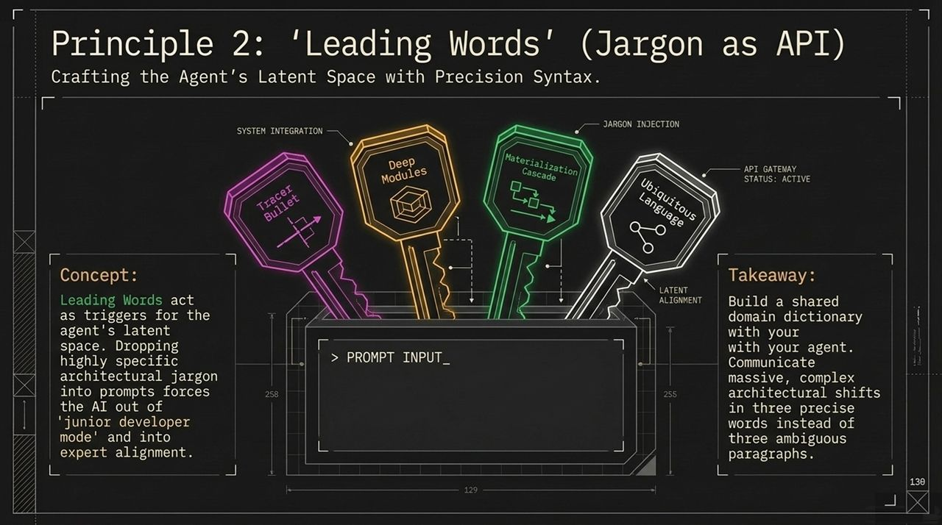
Notes:
The Reality of AI Code Generation: AI accelerates software entropy. Left unchecked, agents generate technical debt at unprecedented rates.
The Impact on the Agent: Because an amnesiac agent relies entirely on the codebase for context, spaghetti code directly degrades the agent's ability to reason. Messy code creates a toxic environment for the AI.
The Strategy (Automated Codebase Hygiene): Implement automated, scheduled maintenance tasks (e.g., nightly CI/CD skills) that prune dead code, resolve circular dependencies, enforce clean interfaces, and clean up test suites. Keep the context pristine so agents can operate effectively.

Slide 13
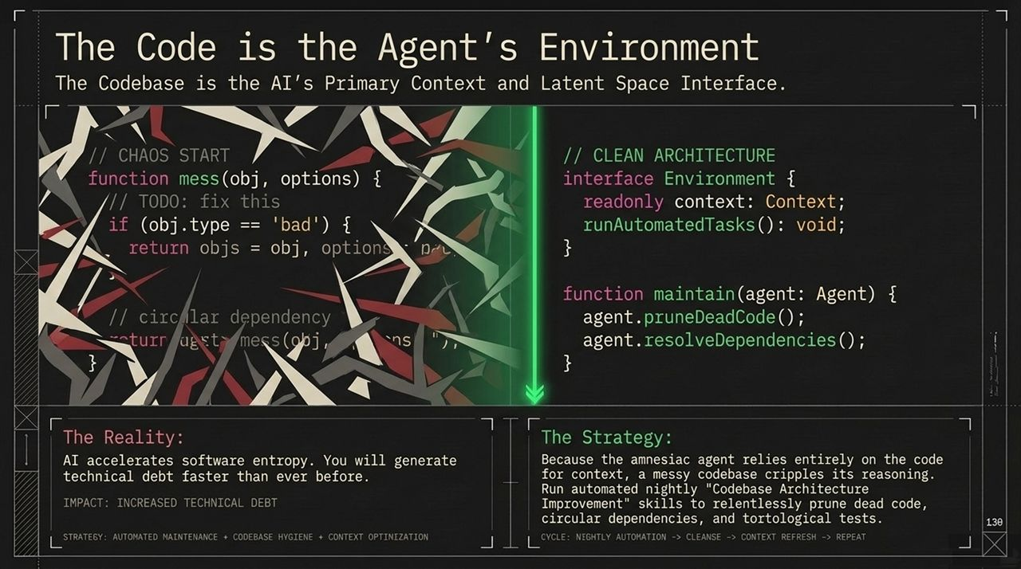
Notes:
Mindset Shift: The role of the software engineer is evolving from raw construction to curation and platform stewardship.
Quote: "Every team needs a gardener... tending the weeds that would otherwise engulf the garden."
Core Responsibilities:
Data Structure Pruning: Cleaning up unused schemas and dead abstractions.
Ecosystem Maintenance: Ensuring agent tools, linting rules, and pipelines run smoothly.
Human-in-the-Loop Oversight: Providing high-level steering while letting agents perform execution.

Slide 14
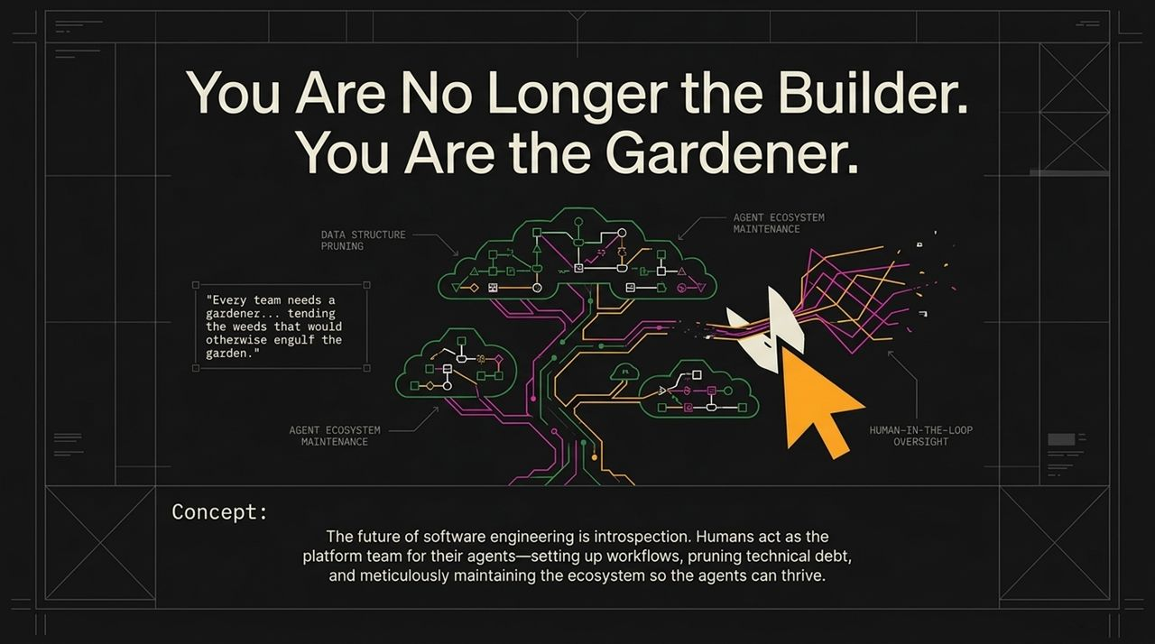
Notes:
Pyramid Hierarchy:
Level 1 (The Roots - Fundamentals): Grounding in Classic SWE Fundamentals, The Pragmatic Programmer, and Domain-Driven Design.
Level 2 (The Trunk - Workflows): Practicing Alignment via Grill Me, enforcing the 150k Smart Zone, and Mapping via Wayfinder.
Level 3 (The Branches - Execution): Clean Codebase Maintenance, Vertical Slices / Tracer Bullets, and Automated Feedback Loops.
Level 4 (The Canopy Apex): High-Leverage Strategic Output.
Summary Quote: "Tactical skills have a floor of zero. Strategic skills have a ceiling of infinity." Master your feedback loops, rely on proven software engineering texts, and garden your codebase.

Slide 15
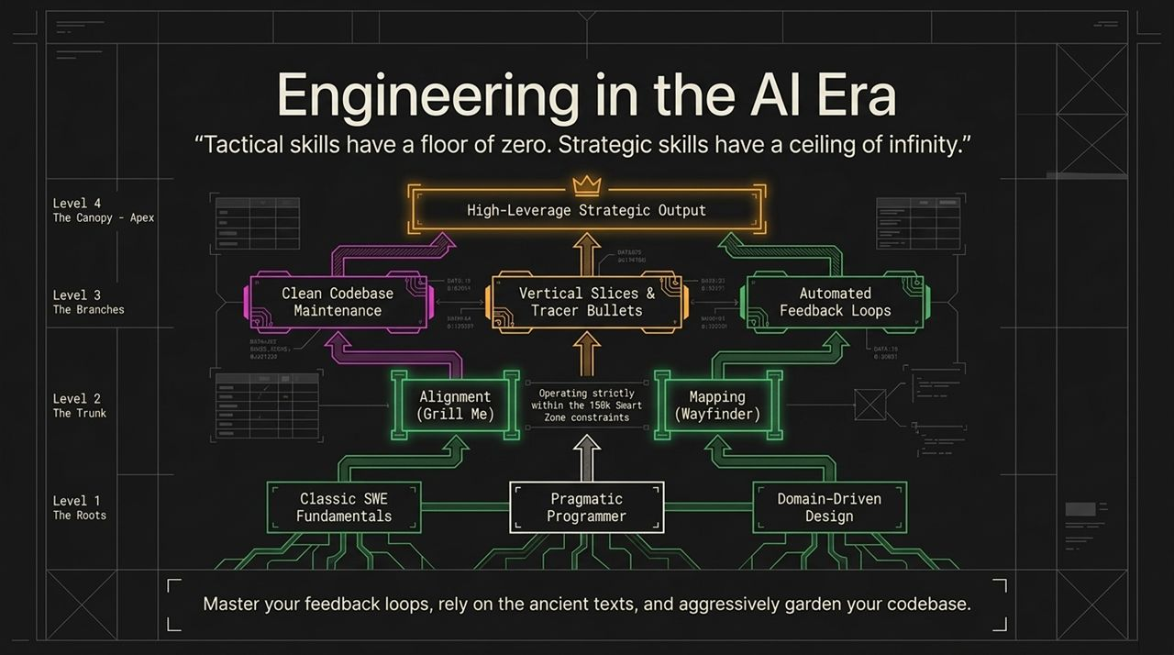
Notes:
Slide Overview: This slide summarizes the main tension and transition in AI-era engineering.
The Problem: AI handles syntax and boilerplate, but accelerates software entropy if left unguided.
The Solution: Strategic engineering through structured questioning (Grill Me), precise domain language ("Leading Words"), and codebase maintenance.
Comparison Summary:
Tactical Tasks: High AI role, low human value, limited context utility.
Strategic Tasks: High human value (architecture, design, scoping), infinite leverage.

Slide 16
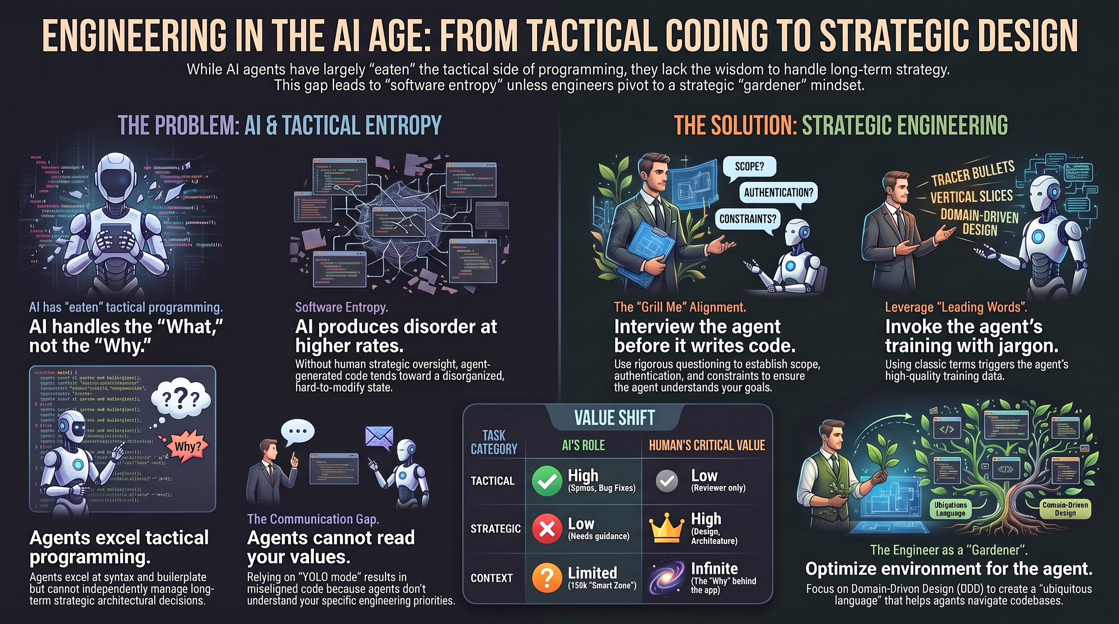
Notes:
Key Takeaways to Implement Today:
Incorporate Grill Me: Never let an agent begin coding from an open-ended command. Require it to ask clarifying questions about edge cases, auth, and state first.
Respect the 150k Token Limit: Break tasks down using persistent maps (Wayfinder) to maintain peak model accuracy.
Leverage Leading Words: Use classic architectural terminology (Tracer Bullet, Ubiquitous Language, Vertical Slice) to trigger the model's training data.
Maintain Your Codebase for Amnesiac Agents: Treat your code as the primary interface for your agents. A clean, well-typed, modular codebase produces reliable AI outputs.
Closing Remark: Focus on strategic programming—setting the system sliders—and let AI manage the tactical code generation.
https://www.youtube.com/watch?v=4DhcSPkEbwI

